Slide 1
DESKTOP VIRTUAL ASSISTANT
Submitted by: Guide: Ms. Anshula GUPTA
Suraj Gupta
Sushant Pandey
Srijan shahi

Slide 2
INTRODUCTION
In this project, the user is just expected to give voice commands, and the rest work is done by our voice assistants which can automate the complete process and completes our task. As Virtual Assistants perform tasks as a human can. It can send emails, play music, and talk to you accordingly.

Slide 3
Abstract
The Desktop Virtual Assistant is a software system designed to assist users with daily tasks, such as scheduling appointments, setting reminders, and performing web searches. The software is developed to be user-friendly and easy to interact with, using natural language processing to understand user commands and respond with relevant information and actions.

Slide 4
PROBLEM STATEMENT (reason to work)
Understanding user voice commands.
Can't read or send SMS/Emails.
Security Issues
Not able to read Notifications
No desktop software is available
Eavesdropping Aspect (Off automatically when there are no commands from the user end)

Slide 5
OBJECTIVE
Existing Virtual Assistants have some limitations like can’t read messages, and can’t access other web applications. To overcome these limitations, we will integrate various APIs to eradicate those limitations which will save time, and enhance productivity.

Slide 6
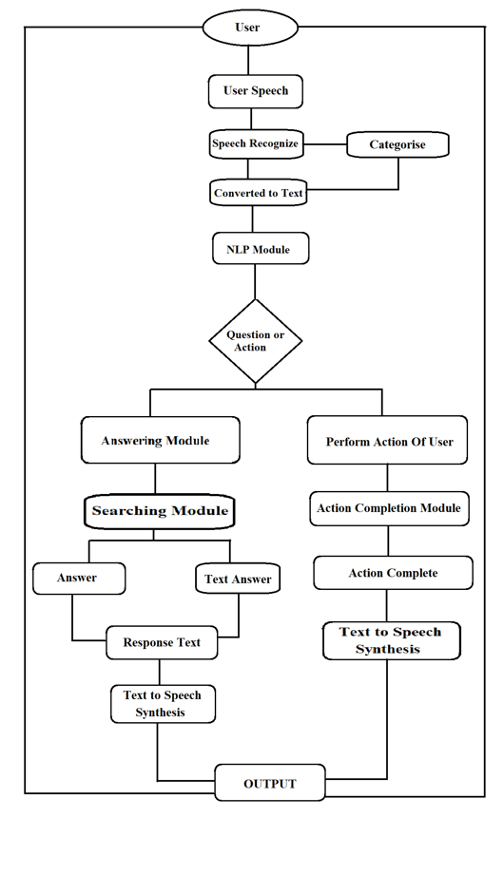
Workflow of Voice Assistant

Slide 7
PyPDF2: It is a python module that can read, split, and merge any PDF.
Web browser: It provides an interface for displaying web-based documents to users.
Pyautogui: It is a python library for the graphical user interface.
os: It represents Operating System-related functionality.

Slide 8
Hardware Requirements
Computer
Microphone
Speakers
Webcam: A webcam may be necessary for enabling video-based interaction with the virtual assistant, such as for facial recognition.
Internet Connection: An internet connection is necessary for accessing cloud-based resources, enabling online updates and syncing, and performing other online-based activities.

Slide 9
TECHNOLOGIES
NLU: Refers to the ability of a computer to use syntactic and semantic analysis to determine the meaning of text or speech.
NLG: Enables computing devices to generate text and speech from data input.
Natural Language Processing (NLP) Libraries: NLP libraries such as NLTK (Natural Language Toolkit), SpaCy, and Stanford CoreNLP can be used to implement the virtual assistant's ability to understand and interpret natural language commands and queries.
Voice Recognition Software: Voice recognition software such as Google Speech Recognition, Microsoft Speech API, and Amazon Transcribe can be used to enable voice-based interaction with the virtual assistant.
Integrated Development Environments (IDEs): PyCharm,.

Slide 10
CONCLUSION
A voice assistant, without any doubt, as it saves time for the user through conversational interactions, effectiveness, and efficiency. But while working on this project, there were some limitations encountered, and also realized some scope for enhancement in the future.

Slide 11
THANK YOU!!

